Slide 1
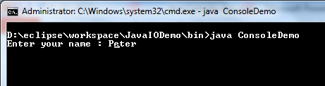
Java Console class
The Java Console class is be used to get input from console. It provides methods to read text and password.
If you read password using Console class, it will not be displayed to the user.
The java.io.Console class is attached with system console internally. The Console class is introduced since 1.5.
Console
Java Application
Read
Read

Slide 2
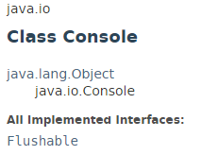
Java Console class

Slide 3
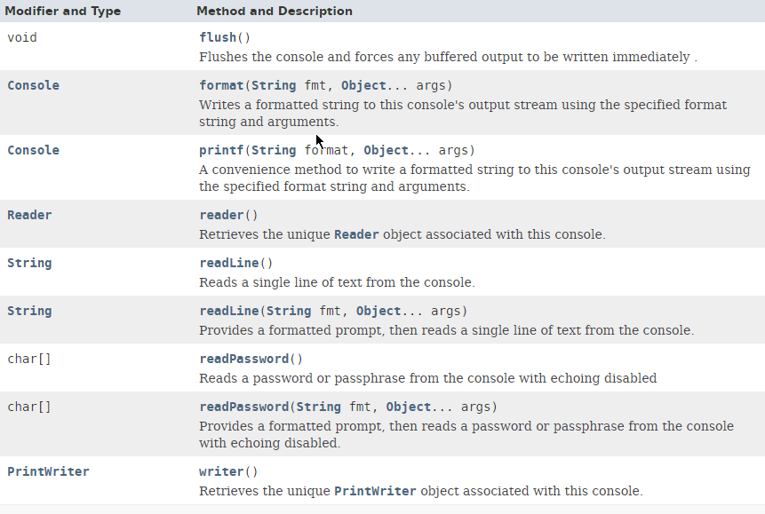
Java Console class

Slide 4
Java Console class
https://docs.oracle.com/javase/8/docs/api/index.html?java/io/Console.html

